Slide 1


Suicide Rate
Feb 2022
Group 8

Slide 2

01 Chapter/ Introduction
02 Chapter/ Reasons
03 Chapter/ Questions
04 Chapter/ Data description
05 Chapter/ Data Exploratory
06 Chapter/ Machine Learning Model
07 Chapter/ Results
|
Group 8

Slide 3
Introduction
Suicide is a serious global public health issue not limited to any single factor
more
it accounts
700 000
1.3%
people die by suicide every year (WHO)
of death worldwide
|
Group 8

Slide 4
Reasons
Suicide Factors
Prevention
Impacts of Time
Understanding the relationship between suicide rates and different demographic, socio-economics and health factors can help identify potential individuals at and increased suicide.
With the increasing suicide rates in recent years, the need for increased awareness, education, and resources to address this issue is getting highlighted.
Understanding how the factors that impact suicide rates change over time and across countries.
-
|
Group 8

Slide 5
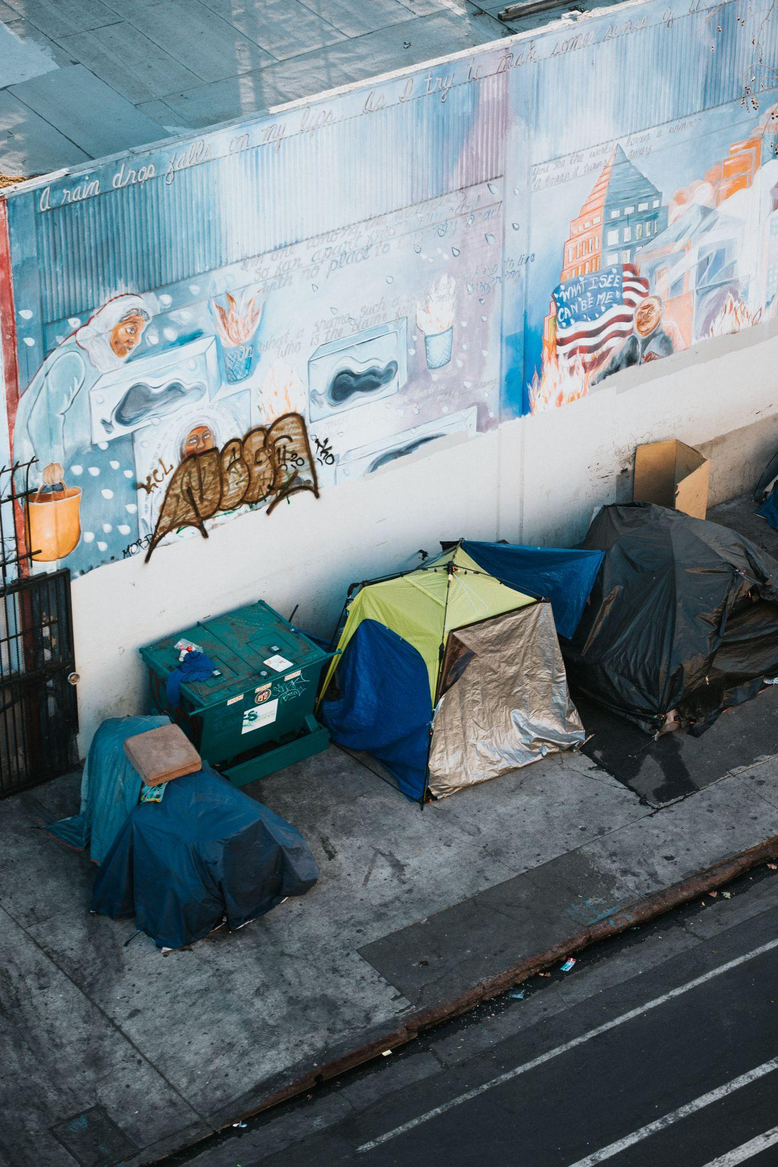
Is there a correlation between suicide risk and socio-economic status and/or health data?
What is the most significant factors impacts suicide rate?
What country has highest and lowest risk of suicide in the next year?
| Group 8

Slide 6
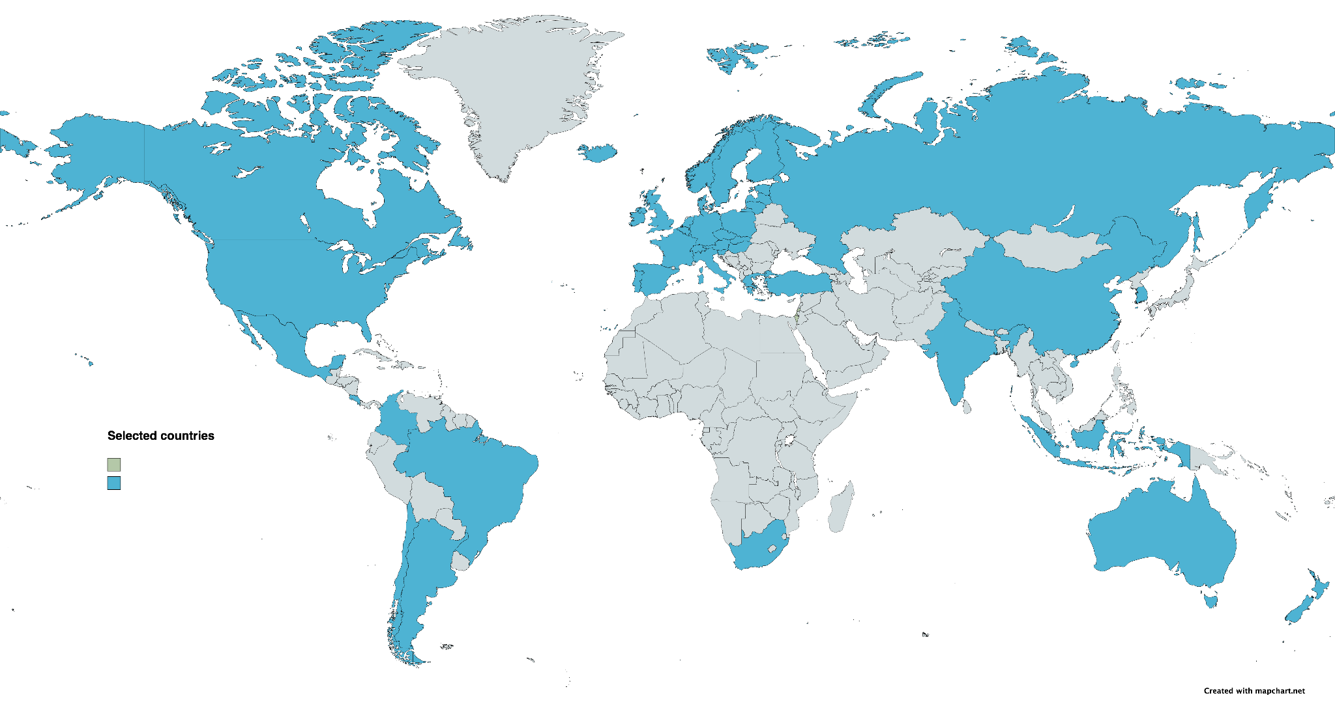
Data
Description
Countries
Argentina, Australia, Austria, Belgium, Brazil, Canada, Chile, China, Colombia, Costa Risa, Czech Republic, Denmark, Estonia, Finland, France, Germany, Greece, Hungary, Iceland, India, Indonesia, Ireland, Israel, Italy, South Korea, Latvia, Lithuania, Luxembourg, Mexico, Netherlands, New Zealand, Norway, Poland, Portugal, Russia, Slovak Republic, Slovenia, South Africa, Spain, Sweden, Switzerland, Türkiye, United Kingdom, United States
|
Group 8

Slide 7
Data Description
Education Data separates the population into two categories: below upper-secondary and tertiary education.
Employment Data percentage of the total population on age of 15 to 64 that is working
Suicide Data represents the total numbers in terms of deaths per 100 000 inhabitants (total)
Smoking Data as a percentage of the population considered (total, men or women) aged 15 years and over
Obesity Data is based on the body mass index (BMI), measured as a percentage of the population aged 15 years and older.
Social Spending Data contains indicator is measured as a percentage of GDP or USD per capita
Health Spending Data indicates as a share of GDP, as a share of total health spending and in USD per capita
Alcohol Data is defined as annual sales of pure alcohol in litres per person aged 15 years and older
|
Group 8

Slide 8
Data Clean Process
1
2
3
4
5
6
Data Type
Filter columns
Pivot table
Null values
Merge Datasets
Remove Columns
convert the 'Time' column to string to create an unique identifier column 'LocationTime'
'Flag Codes', 'Measure', 'Indicator' and 'Frequency' because it did not have any relevant data for the prediction
filter by the 'Time' column to include values between 1990 and 2020
create a separate column for each 'subject' group
handle all the null values doing the average for it
merged all the 8 tables to a single dataset by the 'LocationTime' column.
|
Group 8

Slide 9
Machine Learning
|
Group 8

Slide 11
Technologies
Jupyter Notebook
Pandas
DBD
PostgreSQL
|
Group 8

Slide 12
Links

